Slide 1
Mathematics For Computing Digraphs & Relations - Example
www.Stats-Lab.com

Slide 2
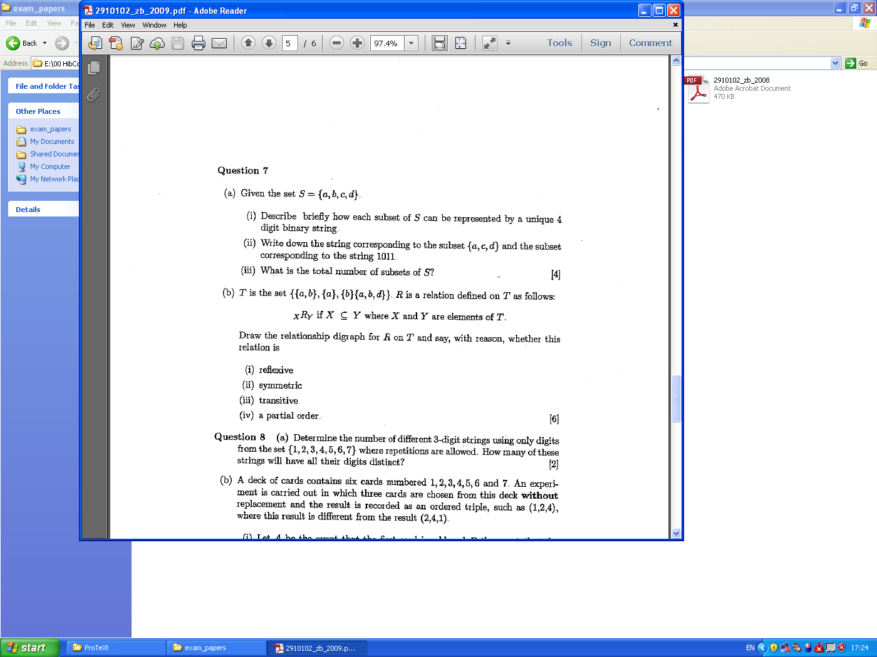
Relations - Example

Slide 3
Relations - Example

Slide 4
Relations - Example
The vertices of the digraph represented sets: {a}, {b}, {a, b} and {a, b, d} and there were directed arcs between vertices when one set was a subset of the other.

Slide 5
Relations - Example
This relation is reflexive, not symmetric and transitive.
Recall: R is anti-symmetric if and only if the relationship digraph of R has no directed cycles of length two.
As the relation is also anti-symmetric, it is a partial order.

Slide 6
Relations - Example
This relation is reflexive, not symmetric and transitive.
Recall: R is anti-symmetric if and only if the relationship digraph of R has no directed cycles of length two.
As the relation is also anti-symmetric, it is a partial order.

